Slide 1
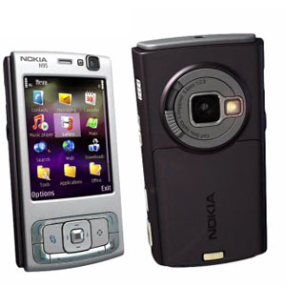
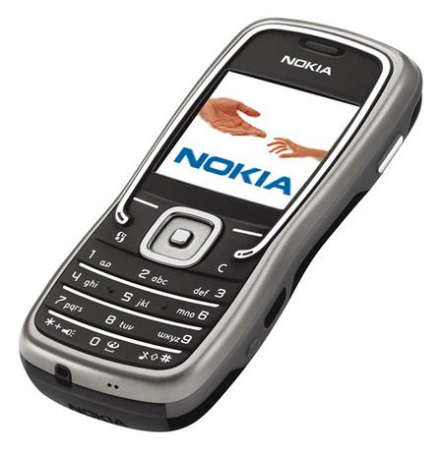
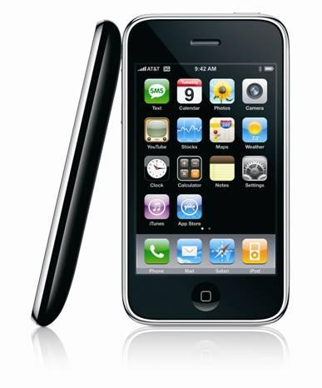
Mobile Phones based Continuous Sensing Systems
Kiran Rachuri
kkr27@cam.ac.uk
Computer Laboratory
University of Cambridge

Slide 2



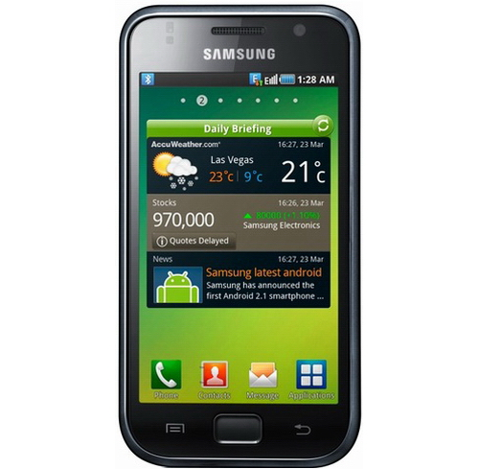

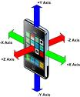

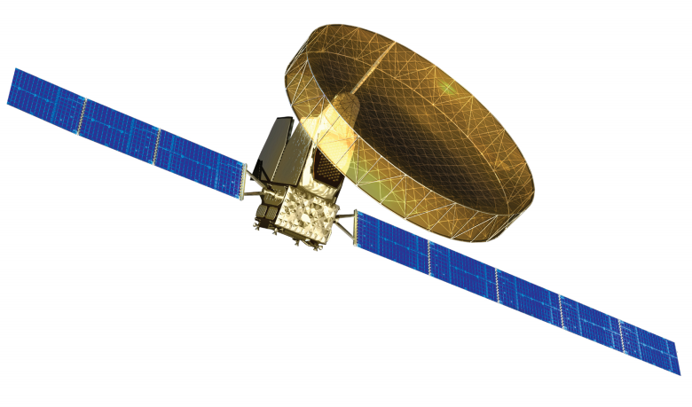
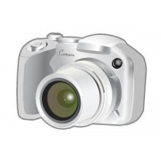
Sensors in a Smart Phone
Microphone
Magnetometer
GPS
Bluetooth
Accelerometer
Camera
Ambient light
Proximity

Slide 3
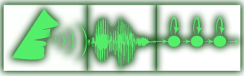
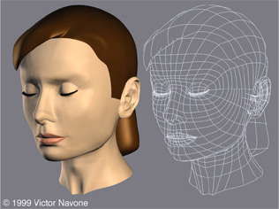

What Can be Done
Microphone – Speaker Recognition
Camera – Face Recognition
Accelerometer – Activity Recognition

Slide 4

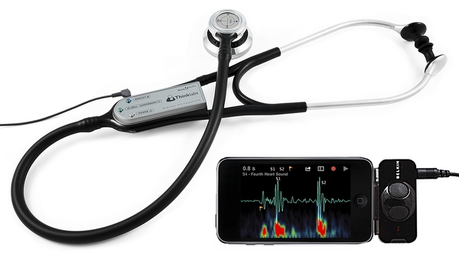
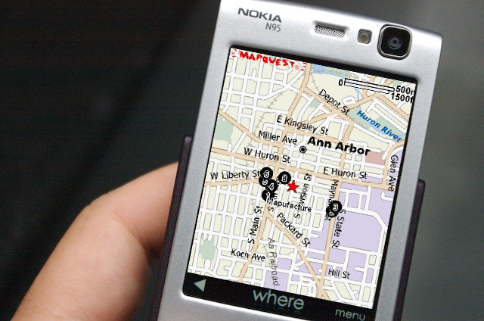
Application Scenarios
Social sensing
Health monitoring
Location based services

Slide 5
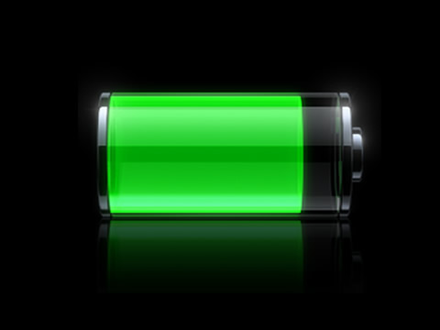
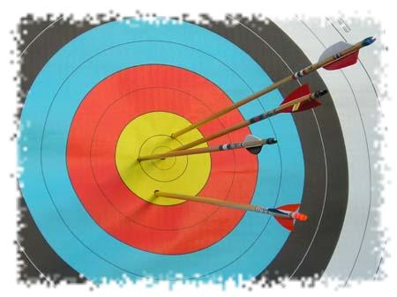
Continuous Sensing Mobile Systems
Sense continuously
Energy-Accuracy trade-offs

Slide 6
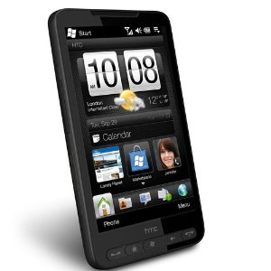
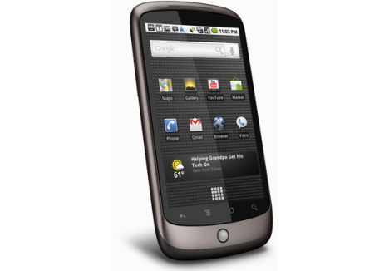
Mobile Phone Limitations
Energy, processing, and memory constraints
Google Nexus One, and HDC HD2 are equipped with1GHz processor and 512MB RAM
Energy is still a scarce resource

Slide 7
EmotionSense

Slide 8


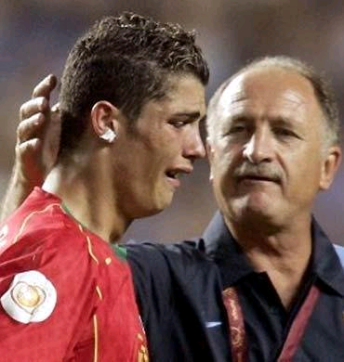






Social Psychology - Emotions
Emotions of users and how they are influenced

Slide 9
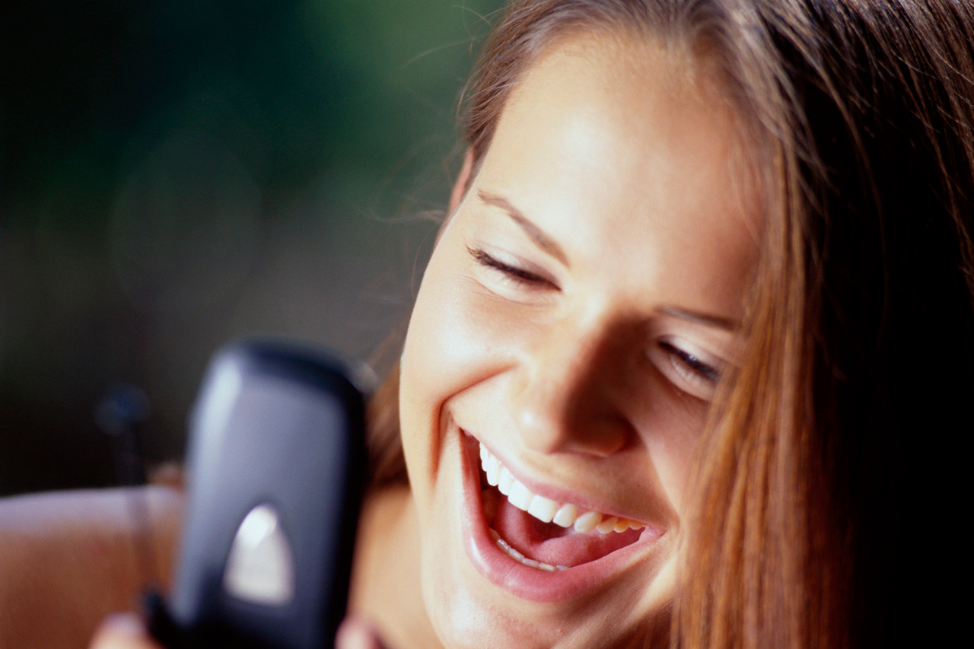
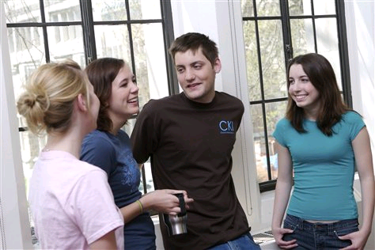
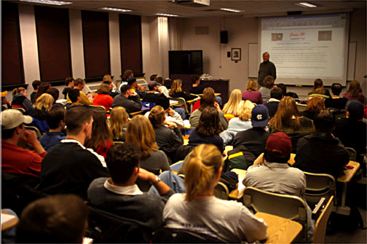
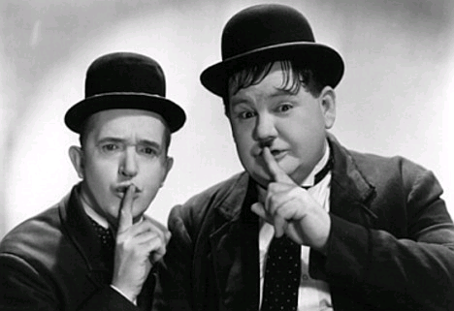
Social Psychology - Speech Patterns
Speech patterns of users

Slide 10


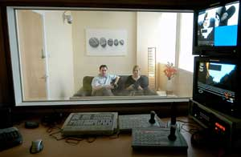
Social Psychology - Existing Methods
Self reports
  But they are biased towards positive emotions
One-time behavioural study in laboratory
  Users hide their natural behaviour
Oh yes, I was very happy today

Slide 11
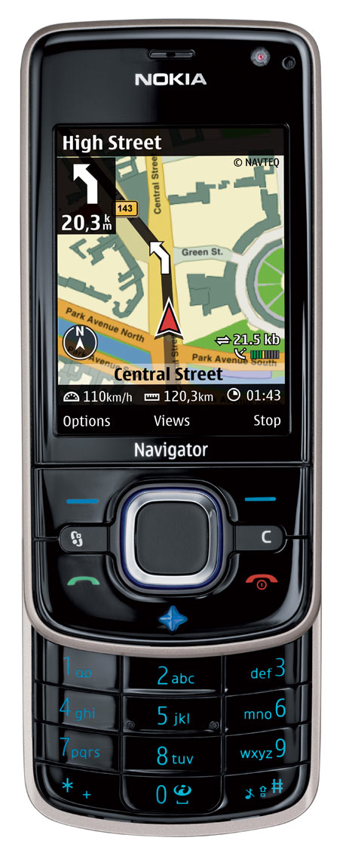
Our Solution
Use Mobile phones
  Powerful sensors
  Ubiquitous
  Unobtrusive
Challenges
  Sensors not built for this purpose
  Battery powered
  Processing
  Main memory limitations
  Privacy concerns

Slide 12
EmotionSense - Architecture
Implemented in PyS60 and Symbian C++
Inference Engine
HTTP Module
SpeakerMonitor
HTK
EmotionSense Manager
Remote Server
ColocationMonior
Declarative Database
MovementMonitor
LocationMonitor
HTK: Hidden markov ToolKit

Slide 13
EmotionSense – Flow of Data
E.g. fact(action, LocationSamplingInterval, 2)
E.g. User is Moving
E.g. fact(Moving, True)
Classifiers
Facts Base
Inference Engine
Actions Base
E.g. X Y Z of Accelerometer
Sensor Monitors
EmotionSense Manager
Raw data

Slide 14
Emotion & Speech Recognition
Training Procedure
Collect voice data
Train background GMM
User/Emotion specific models
Speaker Recognition: Participants voice data
Emotion Recognition: from library
Load speaker and emotion models on phone
At Runtime
Record voice on phone
Extract PLPs using HCopy
Compare using HERest
GMM: Gaussian Mixture Model
PLP: Perceptual Liner Prediction
Hcopy, HERest: Tools of Hidden markov ToolKit (HTK)
[1] http://htk.eng.cam.ac.uk
[2] M. Liberman, K. Davis, M. Grossman, N. Martey, and J. Bell. Emotional prosody speech and transcripts, 2002.

Slide 15
Emotion Categories
Why?
Clustering of emotions
(a) Used by psychologists (b) Improves accuracy
Broad Emotion | Narrow Emotion
Happy | Elation, Interest, Happy
Sad | Sadness
Fear | Panic
Anger | Disgust, Dominant, Hot anger
Neutral | Neutral normal, Neutral conversation, Neutral distant, Neutral tete, Boredom, Passive

Slide 16
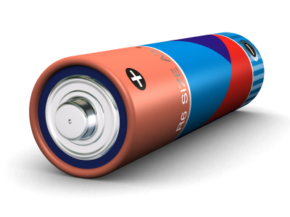
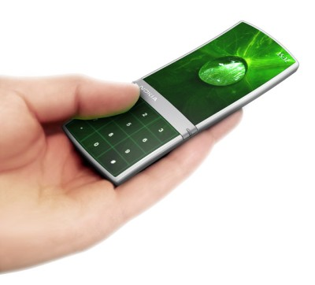
What About Energy?
Optimizations
Adaptive framework

Slide 17


Speaker Recognition - Optimizations
Silence detection
  train an additional GMM using silence audio
Comparisons driven by co-location information
  A recorded audio sequence is compared only with the models co-located users
  This improves accuracy and saves energy

Slide 18
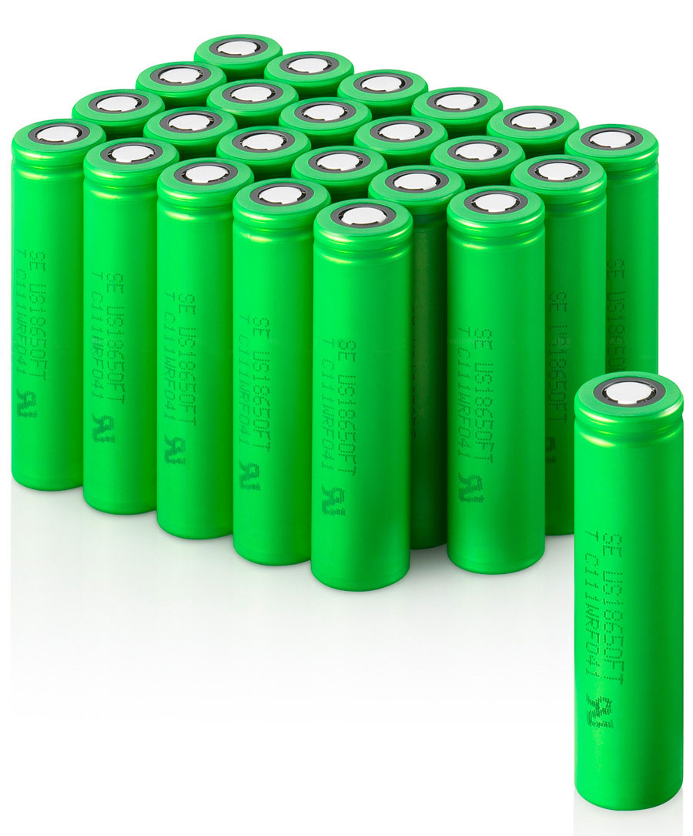
Adaptation Framework
E.g. fact(Moving, True)
E.g. fact(action, GPS, ON)
Facts Base
Inference Engine
Actions Base
Implemented using Pyke, a knowledge based inference engine [http://pyke.sourceforge.net/]
Activate GPS only when user is moving
set_location_sampling_interval
foreach
facts.fact($factName, $value)
check $factName == 'Activity'
facts.fact($actionName, $currentInterval)
check $actionName == 'LocationInterval'
$interval = update($value, $currentInterval)
assert
facts.fact('action', 'LocationInterval', $interval)

Slide 19
Sensor Sampling
Events
Time →
Sleep
Sense
Sleep
Sense
Sleep
Events
Time →
Sleep
Sense
Sleep
Sense
Sleep

Slide 20
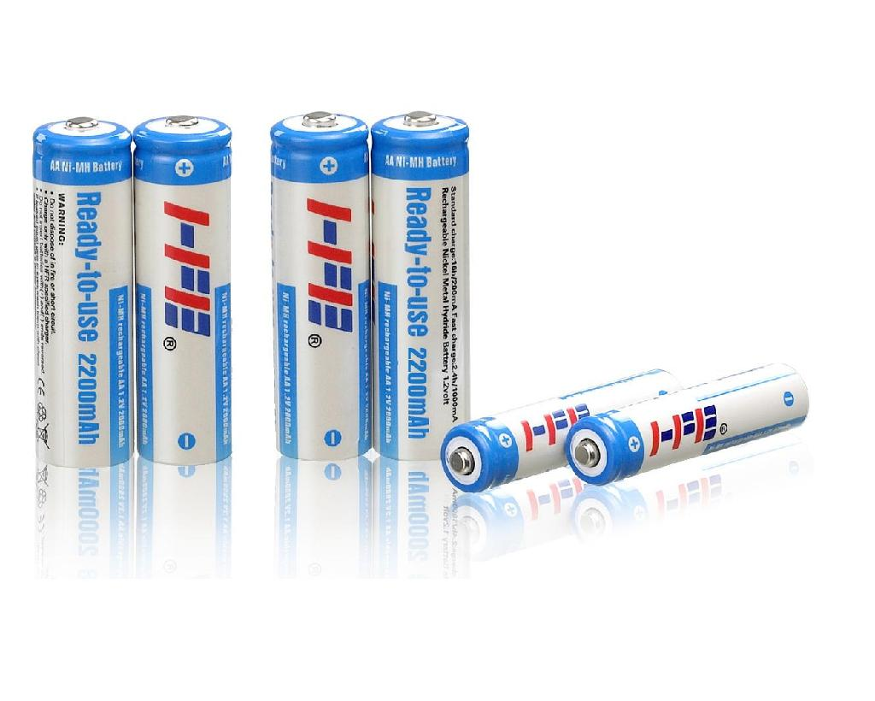
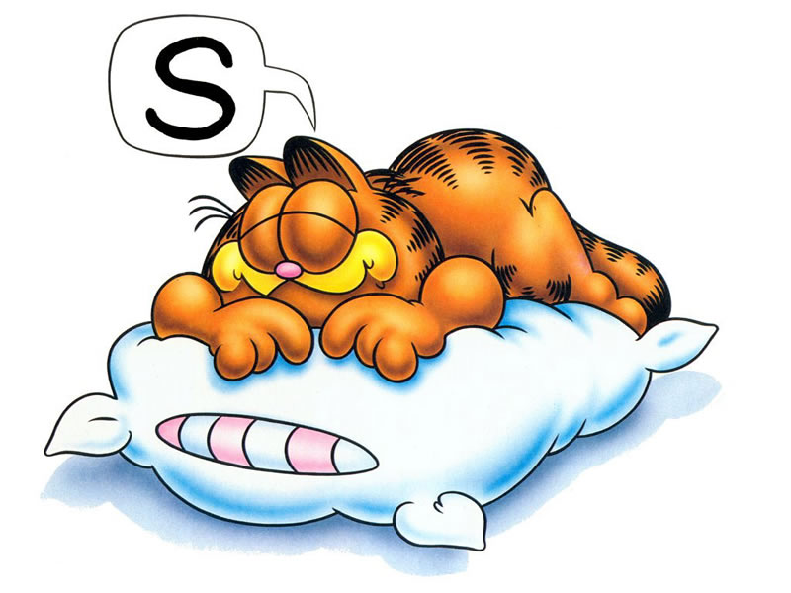
Sensor Sampling Issues
Continuous sampling degrades battery life
Long sleep durations result in loss of sensor data
Not all sensors are similar
Accuracy varies with sensors and classifiers

Slide 21
Sampling Interval
Sleep
Sense Once
Constant
∞
0
Sleep
Minimum Sampling Interval
Maximum Sampling Interval

Slide 22
Design Methodology
Classify events as Unmissable and Missable
Use functions to control the sleep interval
Not all events are important
E.g.: Microphone recording when there is no audible sound
Missable Event
Sense
UnMissable Event
Back-off Function
Advance Function
Sleep
E.g.: f(x) = 2x, where x is sleep interval
E.g.: f(x) = x/2, where x is sleep interval

Slide 23
Back-off and Advance Functions
Type | Back-off function | Advance function
Linear
Quadratic
Exponential
Minimum | N/A | Minimum interval
Maximum | Maximum interval | N/A
x: sleep interval

Slide 24
Dynamic Adaptation
Dynamically switch functions from least to most aggressive
Missable Event
Sense
Sleep
Update Sleep Interval
< Linear Threshold
Linear back-off function
< Quadratic Threshold
Sequence Count
Quadratic back-off function
> Quadratic Threshold
Exponential back-off function

Slide 25


Evaluation
Micro-benchmarks
Social psychology experiment
Meeting experiment

Slide 26
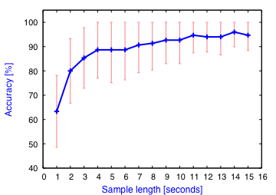
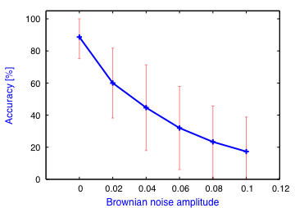
Speaker Recognition - Benchmarks
Accuracy Effect of noise on accuracy

Slide 27
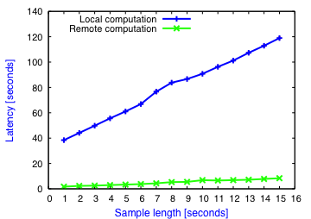
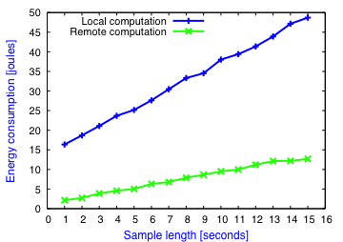
Speaker Recognition – Benchmarks
a) Computationally intensive processing
b) High latency
a) Privacy concerns
b) Users can use their own sim cards
Then why compute locally ?
Why ?
Energy consumption Latency

Slide 28
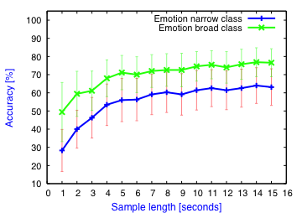
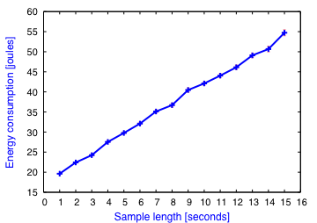
Emotion Recognition - Benchmarks
Clustering helps
Accuracy Energy consumption

Slide 29
Social Psychology Experiment
Nokia 6210 Navigator mobile phones
18 participants, 10 days
Users filled in daily diary questionnaire
Voice data is discarded immediately
All computation performed locally on phone

Slide 30
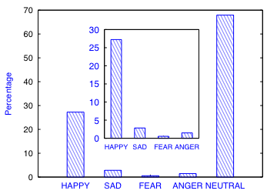
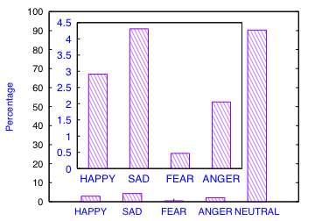
Social Psychology Experiment - Results
Emotion distribution similarity
EmotionSense Self reports
Users indicated ``happy'' emotion to represent their mental state, and not necessarily verbal expression

Slide 31
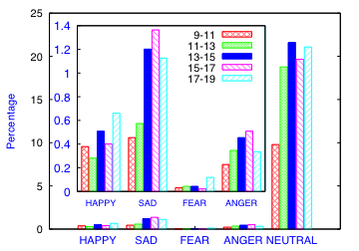
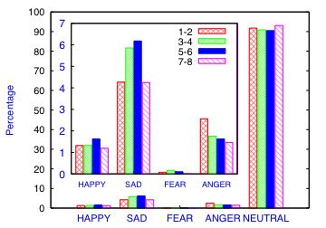
Social Psychology Experiment - Results
Correlation with time of day and co-location

Slide 32
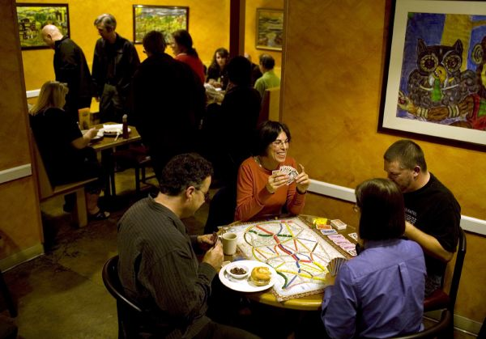
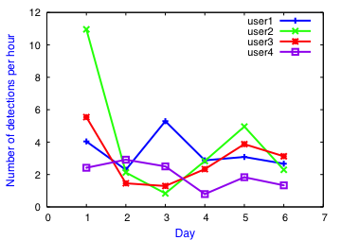
Social Psychology Experiment - Results
EmotionSense can also be used to analyze the speech patterns
Considerable amount of consistency in verbal behaviour

Slide 33


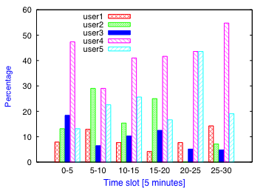
Meeting Experiment
11 participants , 30 minutes discussion
We identified conversation leaders in each time slot of length 5 minutes
The result shows the top five most active speakers

Slide 34
Summary
Continuous sensing mobile systems
EmotionSense
  Speaker and Emotion Recognition
  Sensor Monitors
  Adaptive and Programmable Framework
Evaluation
  Micro-benchmarks
  Social Psychology Experiment
  Meeting Experiment

Slide 35
Thank You
Kiran Rachuri
Computer Laboratory
University of Cambridge
kkr27@cam.ac.uk
EmotionSense http://www.cl.cam.ac.uk/research/srg/netos/emotionsense/

