Slide 1
Welcome to the Computer Laboratory
Student Admin
Dinah Pounds
Megan Sammons

Slide 2
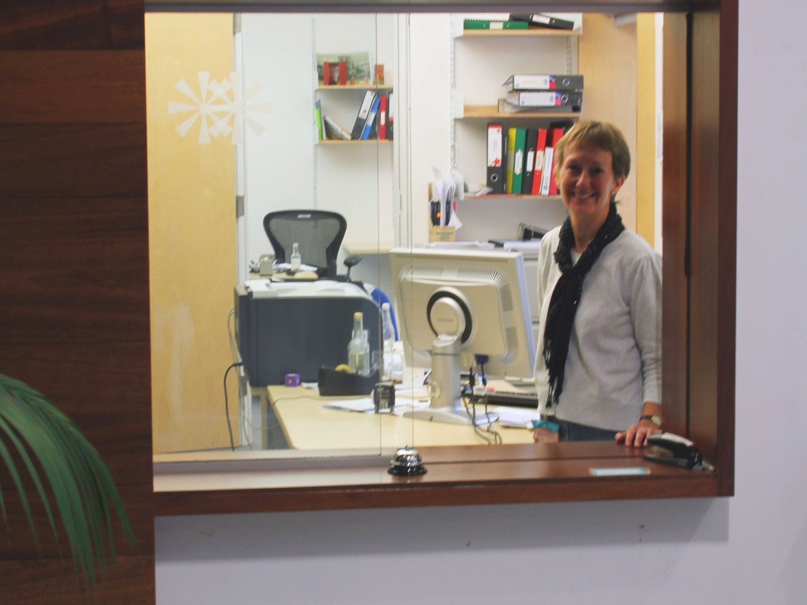
Student Admin Hatch Opening Times
Mon – Fri 9:00 - 4:30
We may close for lunch and tea breaks. Urgent messages can also be taken by reception or email us at teaching-admin@cl.cam.ac.uk

Slide 3
Facilities at the Computer Lab
Part IA lectures take place in the Arts Schools on the New Museum site in the centre of Cambridge but all Part IA students are welcome to come and use the Lab’s facilities.

Slide 4
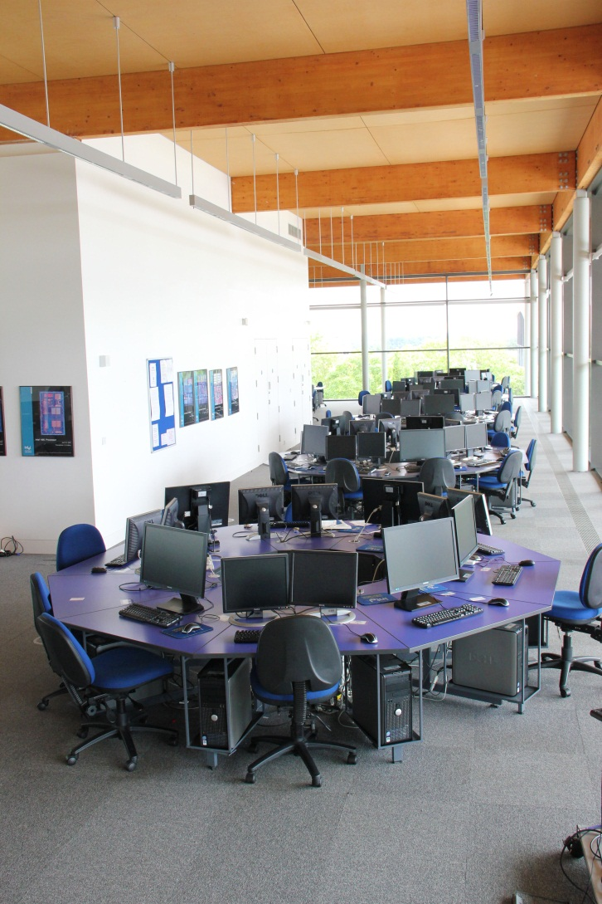
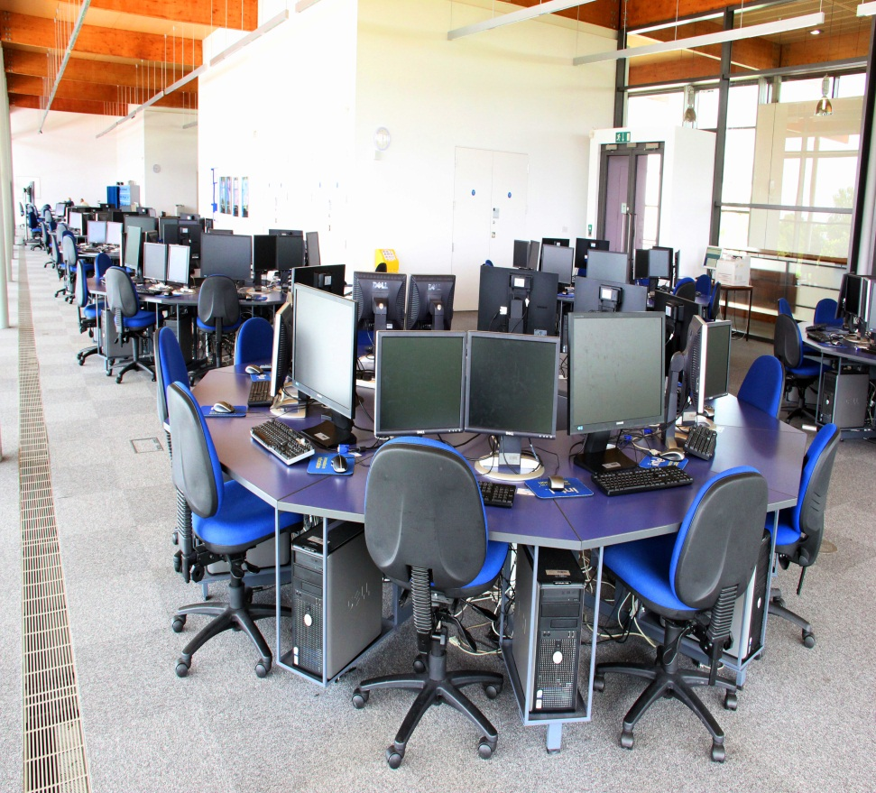
Part IA practical classes take place in the Intel Lab upstairs on the 2nd floor

Slide 5
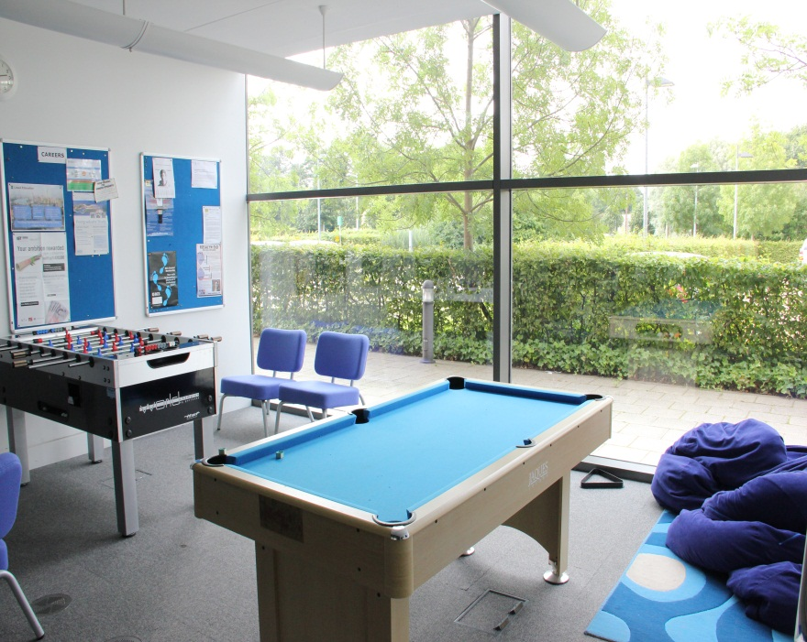
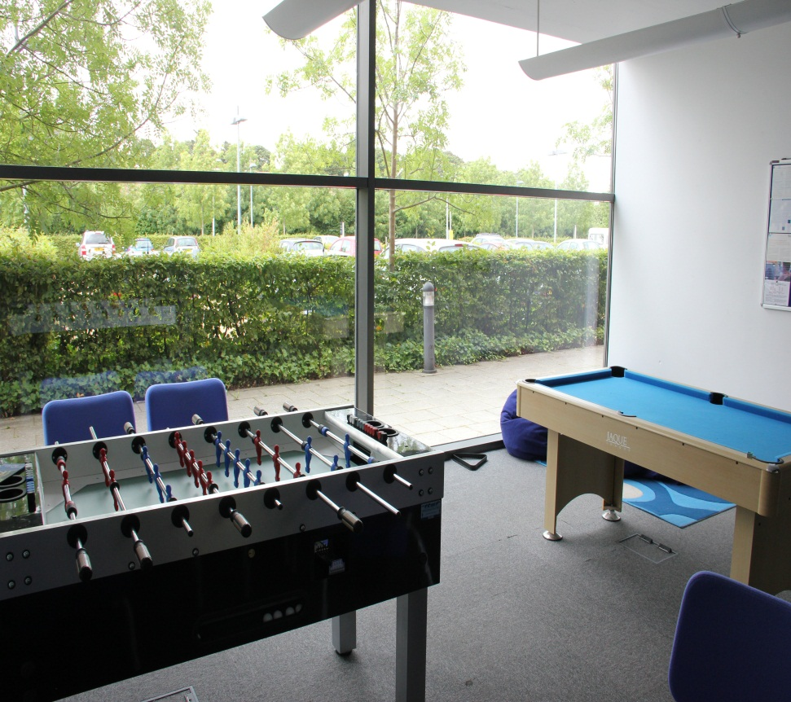
Games room
For relieving RSI! For use by CS students only.

Slide 6
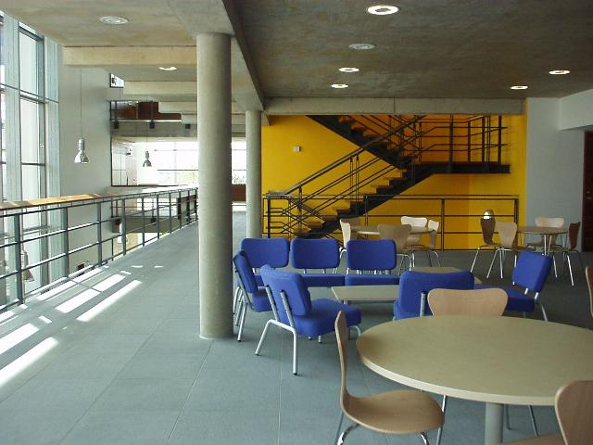
Hang out area
The hang-out area on the 1st floor has up-to-date careers information available and a vending machine for drinks and snacks.

Slide 7
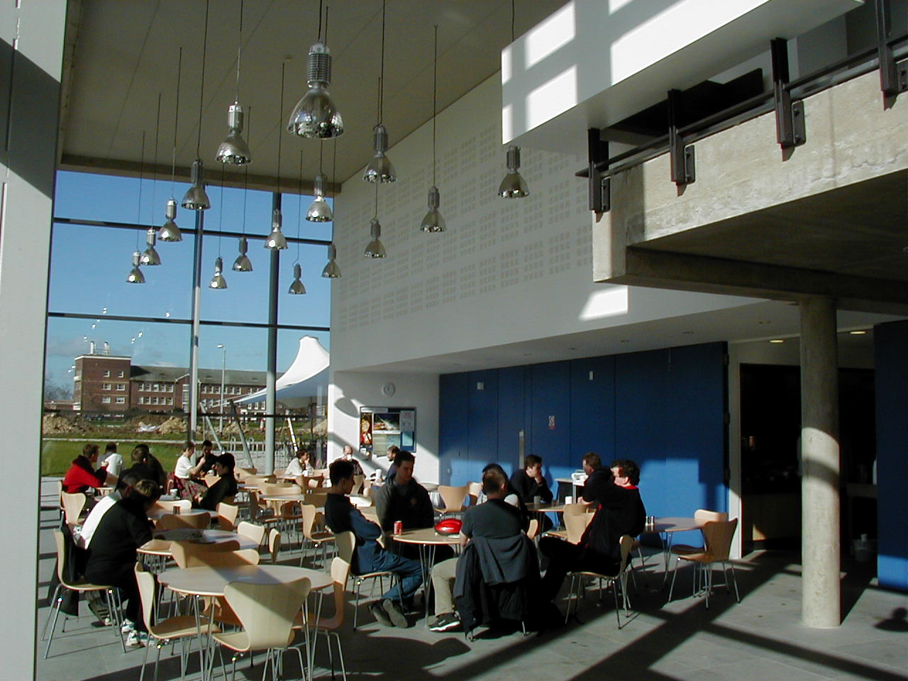
Cafeteria

Slide 8
The Library
Opening Times
Weekdays 9:00 – 17:00 for Part IA and IB.
Part II, III, MPhil and Research students have 24 hour access.
Nicholas Cutler is Librarian at the Computer Lab.
Textbooks
The library holds at least two copies, and sometimes more, of each book on your reading lists.
Journals
The library also subscribes to a number
of journals, where you may read much
of the latest research.
Website
More information about the library and its facilities, including a range of
information leaflets, is available from
our website at www.cl.cam.ac.uk/library

Slide 9
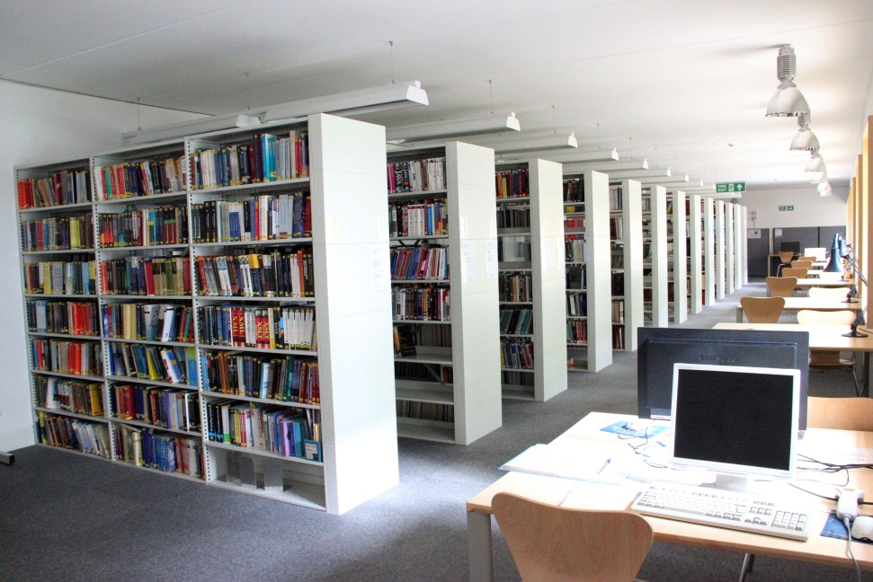
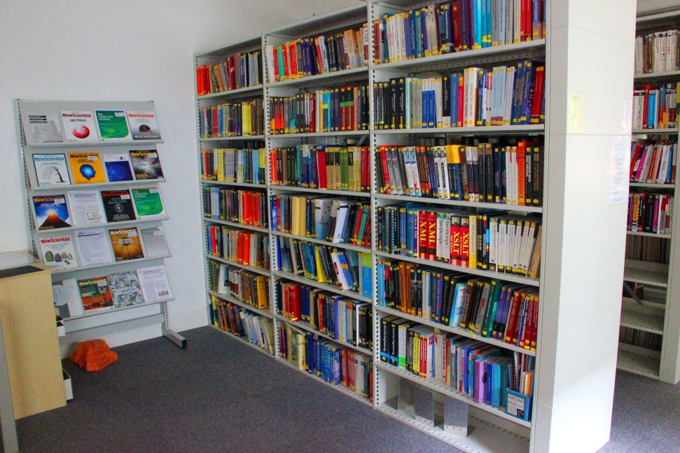
The Library

Slide 10
Events and talks
Wednesday Seminars take place most weeks during term time starting at 14:15. The talks are held by both distinguished external speakers as well as members of the department. Topics span the full range of computer science and beyond. All students are welcome to attend.
Women@cl talks and events are open to both men and women.
Research groups also hold seminars and discussion groups open to all students. Further information is at http://www.cl.cam.ac.uk/seminars/#upcoming

Slide 11
House Rules
The fire alarm here is a spoken word, calm, relaxed alarm, rather than bells and sirens. Once the alarms are sounding, leave all personal belongings behind, leave by the nearest exit and then make their way to the front of the building, Fire Assembly Point F, next to the Bike Shelter.
If you specifically want to use your own electrical equipment in this building it must be PAT (Portable Appliance Testing) tested first. Your college will be able to carry out this test for you. Only 3 pin plugs should be used or you may damage your laptop or set off our RCD circuit breakers. We also have electrical and battery recycling facilities in our stores.
Please – NO food or drink in the Intel lab or Lecture Theatres (bottled water is OK).

Slide 12
Computer Laboratory Supporters’ Club
What is it?
A group of companies, ranging from the very small to the very large, which actively support the Computer Laboratory
What can it do for you?
Help you find summer internships and post graduation jobs
Events
Technical talks, CV and interview workshops throughout the term
Annual recruitment fair (November 21st 2013)
Where to find information
For a list of members and details about job/internship opportunities
go to: http://www.cl.cam.ac.uk/supporters-club/
Details of events will be sent to you by email
Further help from the Outreach Administrator at jan.samols@cl.cam.a.uk

Slide 13
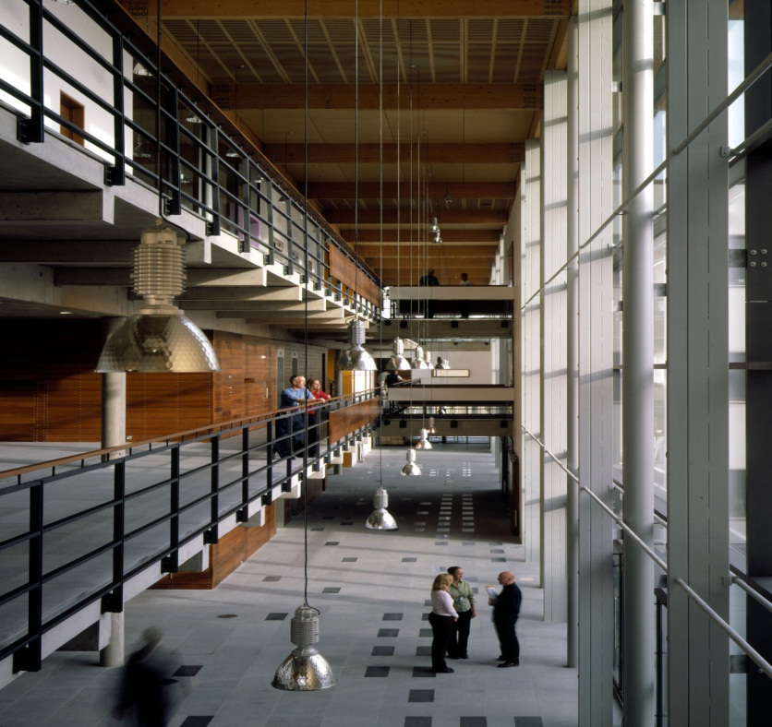
The Street
Refreshments will be available in the street after the talks today. Staff will be around to answer any questions and you are welcome to look round the Library. If you have not already signed to confirm your option and course please do so after the talks.

