Slide 1

Cloud Computing
Large-scale
Resource Management II
Eva Kalyvianaki
ek264@cam.ac.uk

Slide 2
Contents
Apollo: Scalable and Coordinated Scheduling
for Cloud-Scale Computing,
by Eric Boutin, Jaliya Ekanayake, Wei Lin, Bing Shi, and Jingren Zhou, Zhengping Qian, Ming Wu, and Lidong Zhou, in OSDI 2014
Slides and material from the OSDI paper and its presentation from:
https://www.usenix.org/conference/osdi14/technical-sessions/presentation/boutin

Slide 3
Background
Cloud-scale jobs
  Jobs are written using SCOPE, a SQL-like high-level scripting language, augmented with user-defined processing logic.
  Job’s are represented by DAGs
  Tasks are the basic unit of computation
  Tasks are grouped in stages
  Execution is driven by the scheduler

Slide 4
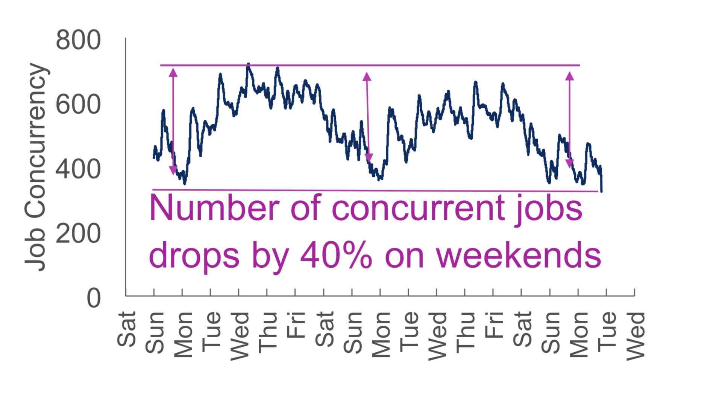
Scheduling at Cloud Scale
minimize job latency while maximizing cluster utilization
Challenges:
  Scale
    Jobs process gigabytes to petabytes of data, 100K scheduling req/sec
    Clusters run 170K tasks in parallel and each has over 20K servers
  Heterogeneous workload
    Tasks run secs to hours
    Can be IO or CPU bound
    Require 100MB to 10GB of memory
    Short tasks are scheduling sensitive
    Long tasks are locality sensitive
  Maximize utilization
    Workload fluctuates

Slide 5
Apollo Overview
Distributed and coordinated architecture
Estimation-based scheduling
Conflict Resolution
Opportunistic Scheduling

Slide 6
Distributed and coordinated architecture

Slide 7
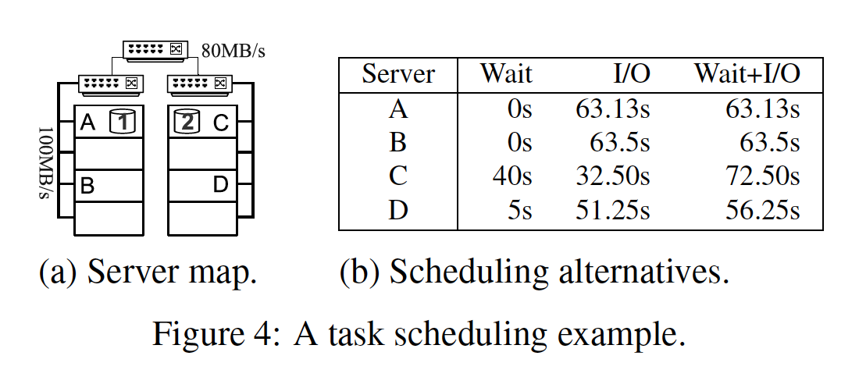
Different factors for optimization

Slide 8
Estimation-based scheduling
Estimated task completion time
Esucc = I + W + R
C = Psucc * Esucc + Kfail*(1−Psucc)*Esucc
  E: Estimated task completion time
  I: initialization time: fetching files for the task
  W: wait time: a lookup in the wait-time matrix of the target server
  R: Runtime: both I/O and CPU time

Slide 9
Conflicts Resolution
Apollo defers the correction of conflicts
  (vs Omega where conflicts are handled at scheduling time)
Re-evaluates prior decisions
Triggers a duplicate if the decision is not optimal with up-to-date data

Slide 10
Opportunistic Scheduling
Maximize utilization
  Use the remaining capacity
  Dispatch more that the resource allocation
  Tasks only consume idle resources
  Tasks can be preempted or terminated
  Tasks can be upgraded
  Limit capacity share of each job
  Random queueing

Slide 11
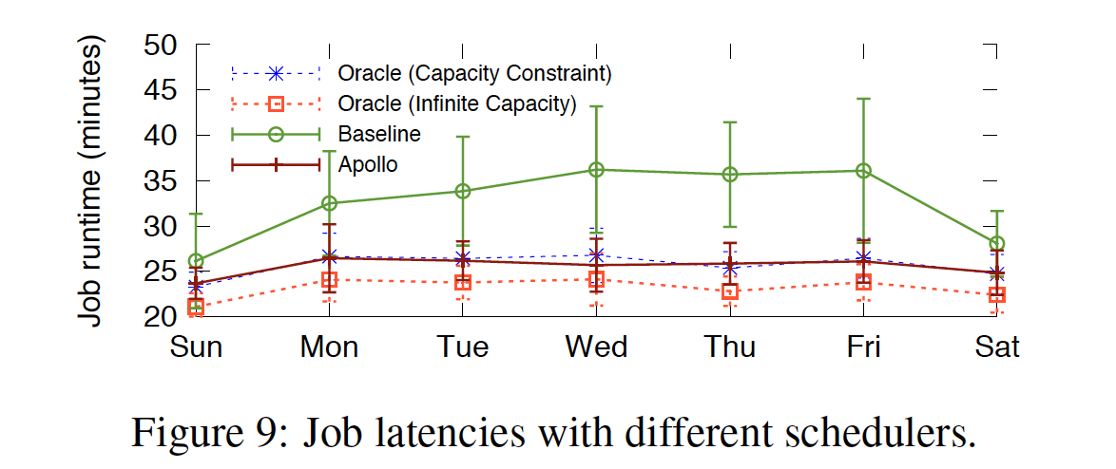
Evaluation
Apollo runs on Microsoft production clusters with over 20K servers each
It runs 170K tasks in parallel
Tracks 14M pending tasks

Slide 12
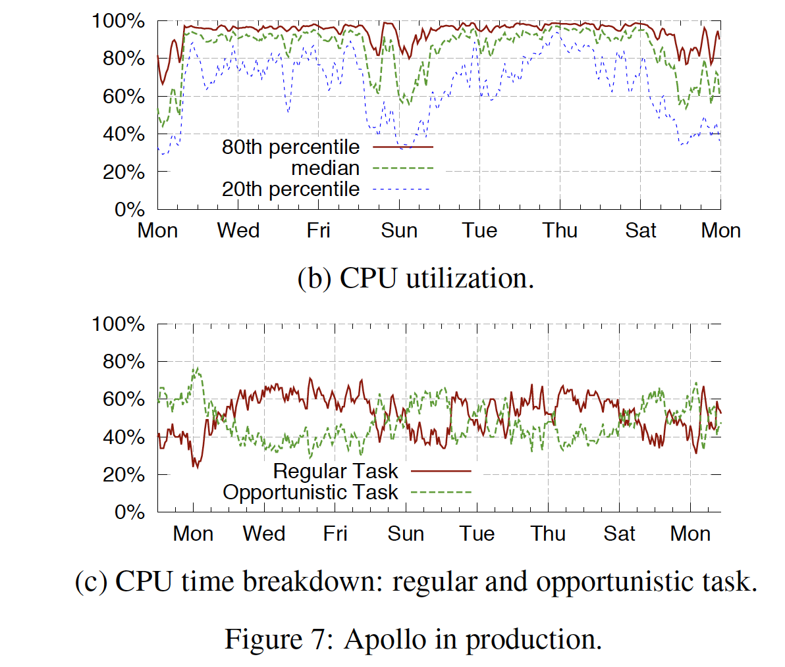
Apollo’s Resource Efficiency

Slide 13
Conclusions
  Loosely Coordinated Distributed Architecture
  Deployed to clusters with over 20K servers
  High Quality Scheduling
  Mininizes task completion time
  Consistent performance
  Maximizes resource utilization
  Opportunistic scheduling
  90% median CPU utilization

